Slide 1
ClubLife
Sasha Hedges, Jonathan Merklin, Brandon Poole, Zach Babka

Slide 2





Updated Problem Definition
STUDENTS:
I am a member of multiple clubs
I want to keep these organized
I want to get updates for my clubs
OFFICERS/LEADERS:
I am a club leader
I want to contact my club members
I want to create events
I want to post to social media

Slide 3
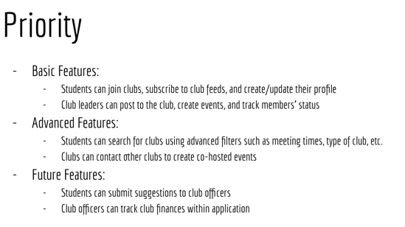
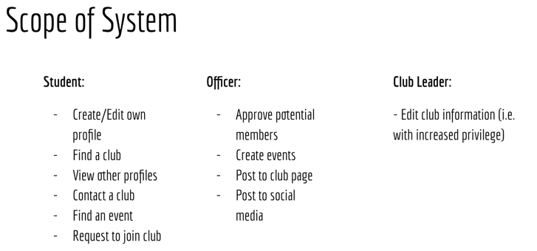
Updated Scope of the System
No changes. Recall that the scope and priority were originally (and still):

Slide 4
Detailed Class Diagram
Notes:
sasha

Slide 5
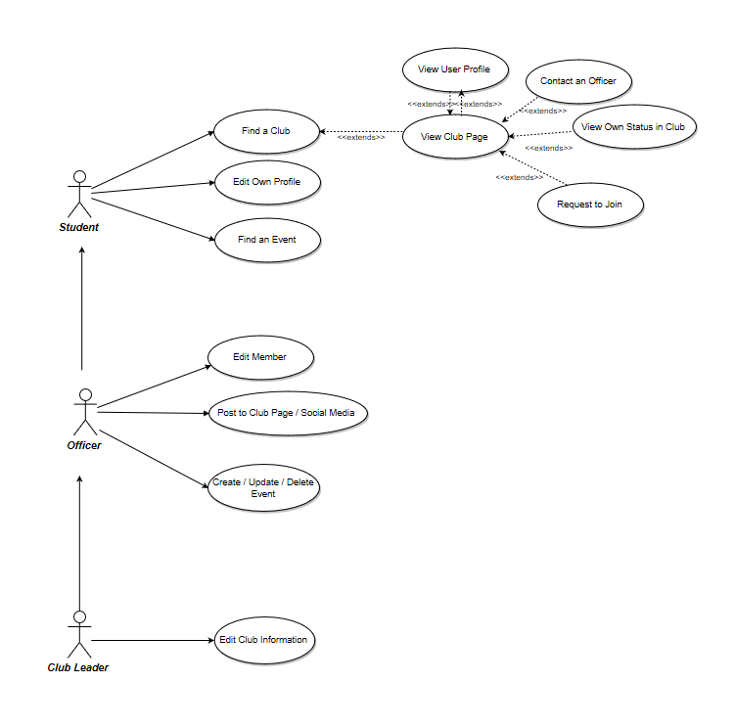
Recall: Use Case Diagram
Notes:
sasha

Slide 6
Sequence Diagram: Find a Club
Notes:
sasha

Slide 7
Sequence Diagram: Contact an Officer
Notes:
sasha

Slide 8
Sequence Diagram: CRUD Event
Notes:
sasha

Slide 9
Sequence Diagram: Edit Member
Notes:
sasha

Slide 10
Sequence Diagram: Edit Own Profile
Notes:
sasha

Slide 11
Sequence Diagram: Edit Club Info
Notes:
sasha

Slide 12
Sequence Diagram: Find an Event
Notes:
sasha

Slide 13
Sequence Diagram: Post to Club Page/Social Media
Notes:
sasha

Slide 14
Sequence Diagram: Request to Join Club
Notes:
sasha

Slide 15
Sequence Diagram: View Club
Notes:
sasha

Slide 16
Sequence Diagram: View Member
Notes:
sasha

Slide 17
Sequence Diagram: View Own Status with Club
Notes:
sasha

Slide 18
Project Changes, Priority Focus Changes
Backend: ASP.NET 5 to ASP.NET Core
For time being, still planning on cross-platform
No longer considering working with Collegiatelink/synchronization
Good news: Data scraped, massaged (their data was not standard format)
Since scope otherwise not different, no other major changes

Slide 19
Summary
Basic backend done(?)
Frontend being started
Documentation done (finally)
Since the requirements, we worked on:
Sequence diagrams
Detailed class diagram
Implementation (i.e. backend)
Refactored requirements and other older diagrams

Slide 20
Opinions of each Member on the Product:
Jonathan: Still concerned re: time constraints.
Sasha: Product is good, time is scary
Zachary: Concerned for time constraints and familiarity with Xamarin
Brandon: Basic functionality looks good. Concerned about time for dynamic features

Slide 21
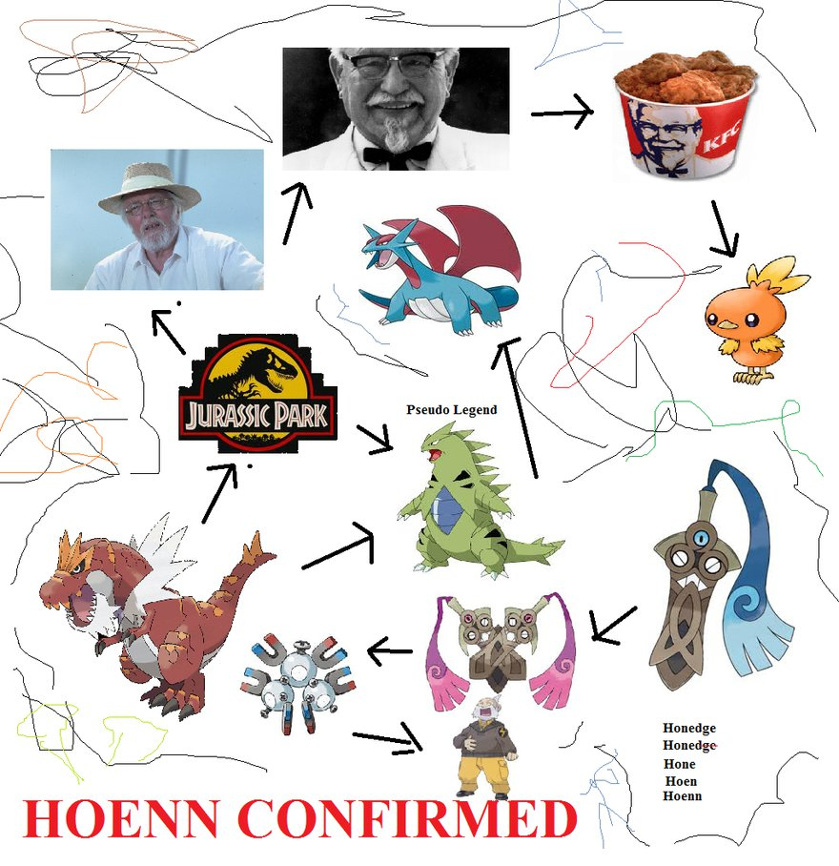
Questions?
Notes:
Brandon

